Slide 1
Generative Adversarial Nets (GAN)

Slide 2
Outline
Introduction of GAN
Introduction of CGAN
Rationale of how GAN works
Simulation results
VaR and ES application for market risk
Macroeconomic time series simulation application

Slide 3
Introduction of GAN
Discriminative vs. Generative models
GAN is a kind of generative model built by neural networks for the generation of realistic samples.
Literature Review
GAN was first introduced in 2014 by a group of researchers at the University of Montreal lead by Ian Goodfellow (now at OpenAI).
Wasserstein GAN (WGAN): Martin Arjovsky, Soumith Chintala, and Leon Bottou1,Courant Institute of Mathematical Sciences, Facebook AI Research. 2017.
Conditional GAN (CGAN): Mehdi Mirza and Simon Osindero, University of Montreal, 2014.
A Large-Scale Study of GAN and its variants by Google Brain in 2018.
GAN for Time Series by Fu et al. (2019) https://papers.ssrn.com/sol3/papers.cfm?abstract_id=3373730,
GAN for Financial Trading Strategies by Koshiyama et al. 2019.
GAN for Stock Market Prediction on High Frequency Data by Zhou et al. 2017.

Slide 4
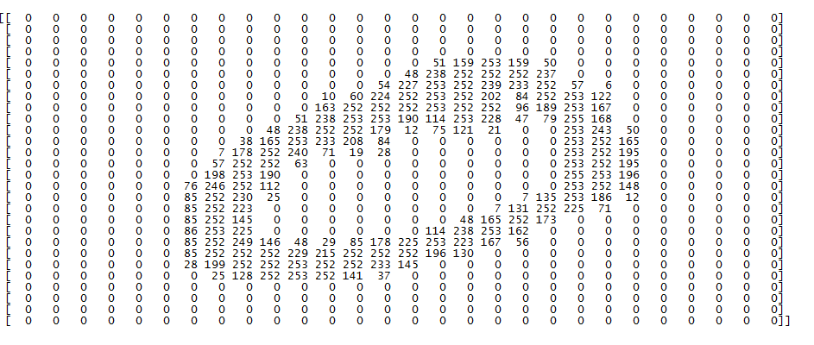
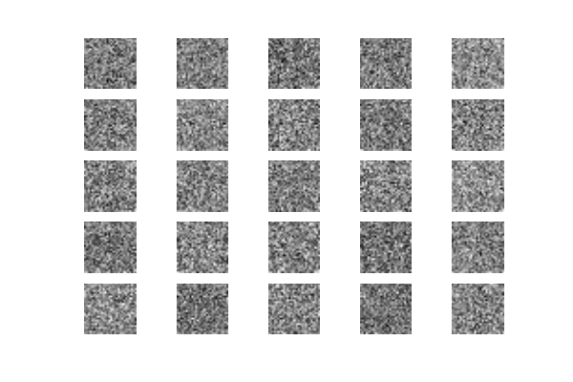
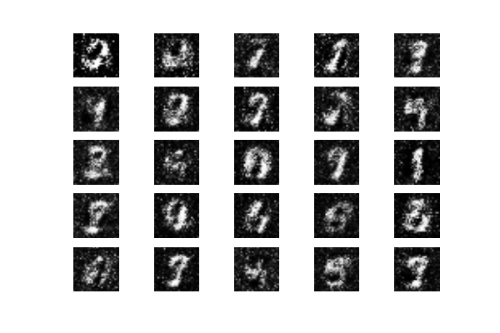
Application on Image Data
Image data format: Sample_size * img_row * img_col
Simulated image data: step 0 to step 900

Slide 5
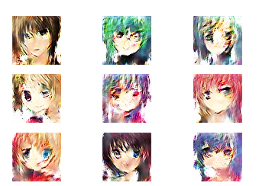
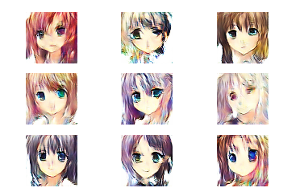
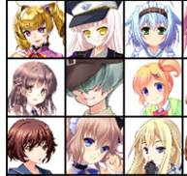
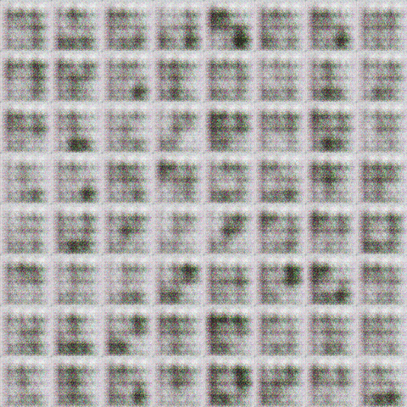
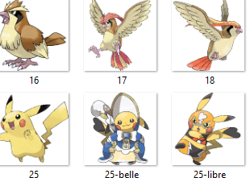

Application on Image Data
Training data
1000 iteration
5000 iteration

Slide 6
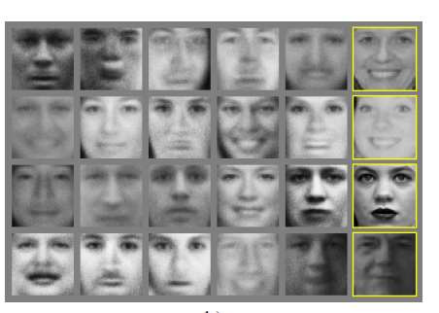
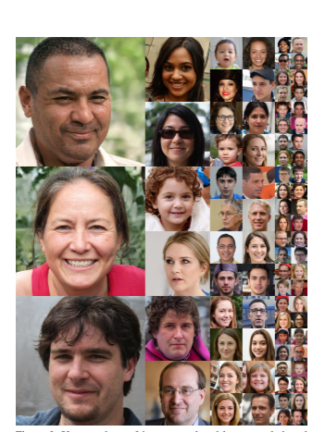
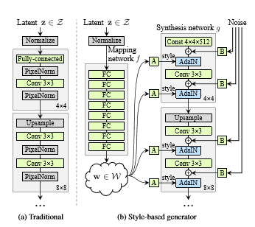
Application on Image Data
GAN 1.0
GAN 2.0: This person does not exits by GAN 2.0: https://www.thispersondoesnotexist.com/

Slide 7
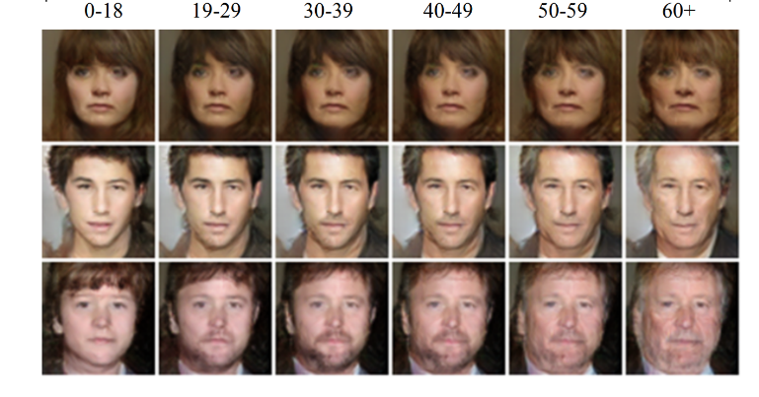
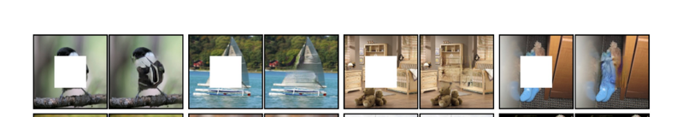
Application on Image Data
Face aging
Image painting

Slide 8
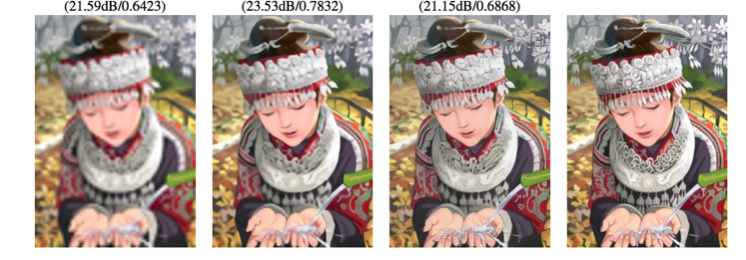
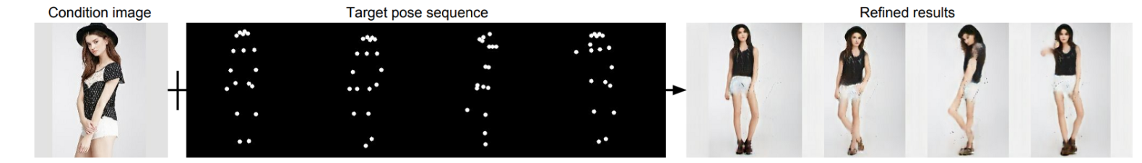
Application on Image Data
Super resolution
Pose Guided Person Image Generation

Slide 9
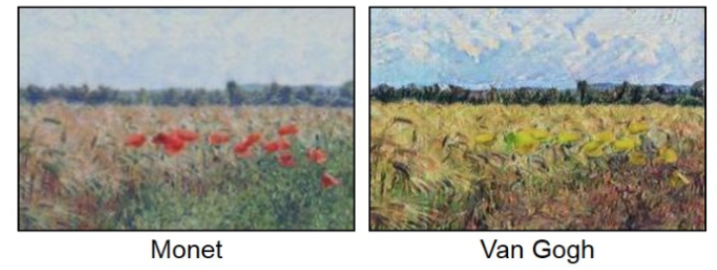
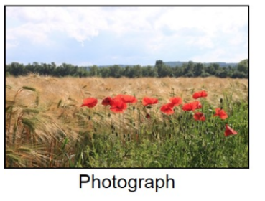
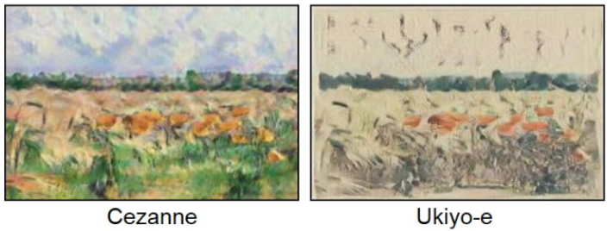
Application on Image Data
Cycle GAN

Slide 10
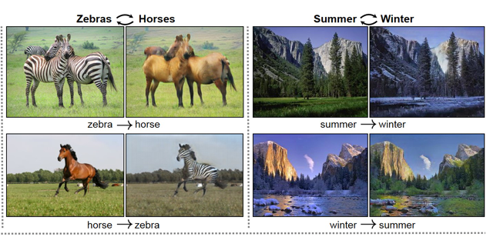
Application on Image Data
Cycle GAN: transform pictures between zebras and horses, and changing of seasons.

Slide 11
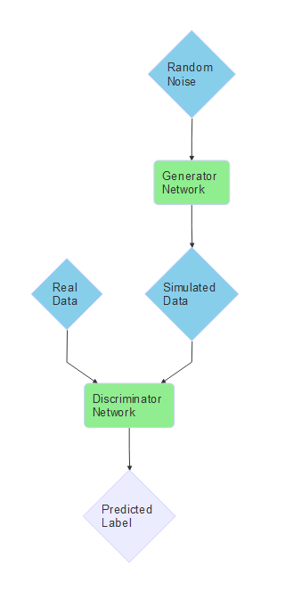
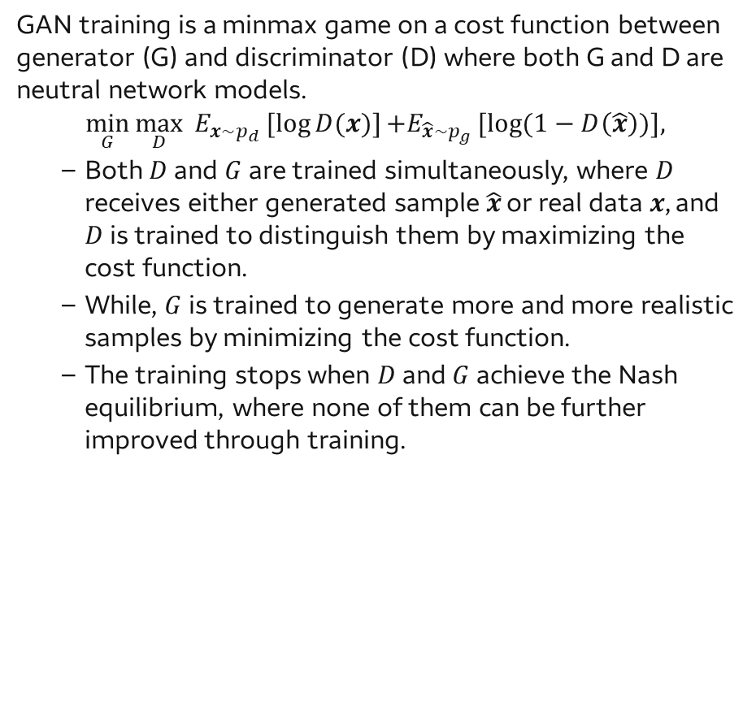
GAN Framework
GAN training is a minmax game on a cost function between generator (G) and discriminator (D) where both G and D are neutral network models.
$$\min_{G}{\max_{D}{E_{x\sim p_{d}}[log{D(x)}]}}{+E_{\hat{x}\sim p_{g}}[log{(1−D\left(\hat{x}\right))}], }$$
Both $D$ and $G$ are trained simultaneously, where $D$ receives either generated sample $\hat{x}$ or real data$x$, and $D$ is trained to distinguish them by maximizing the cost function.
While, $G$ is trained to generate more and more realistic samples by minimizing the cost function.
The training stops when $D$ and $G$ achieve the Nash equilibrium, where none of them can be further improved through training.

Slide 12
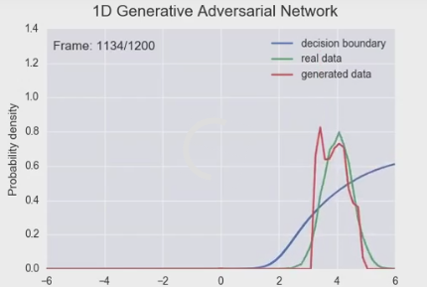
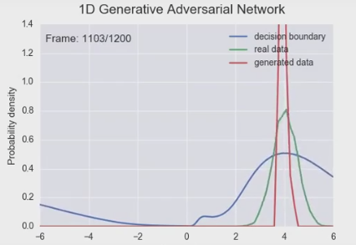
GAN
Issues with GAN:
mode collapse issue : the generator collapses to a parameter setting where it always generates a small range of outputs
Diminished gradient issue: discriminator gets too successful that the generator gradients vanish and the generator learns nothing.
Solution
WGAN (Wasserstein GAN)--a new cost function using Wasserstein distance
DRAGAN--a gradient penalty directly to GAN
GAN
WGAN

Slide 13
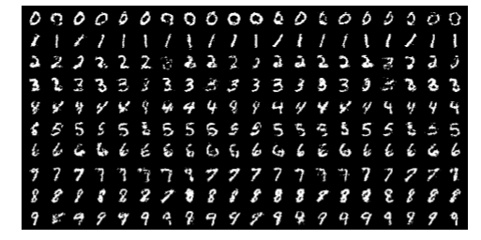
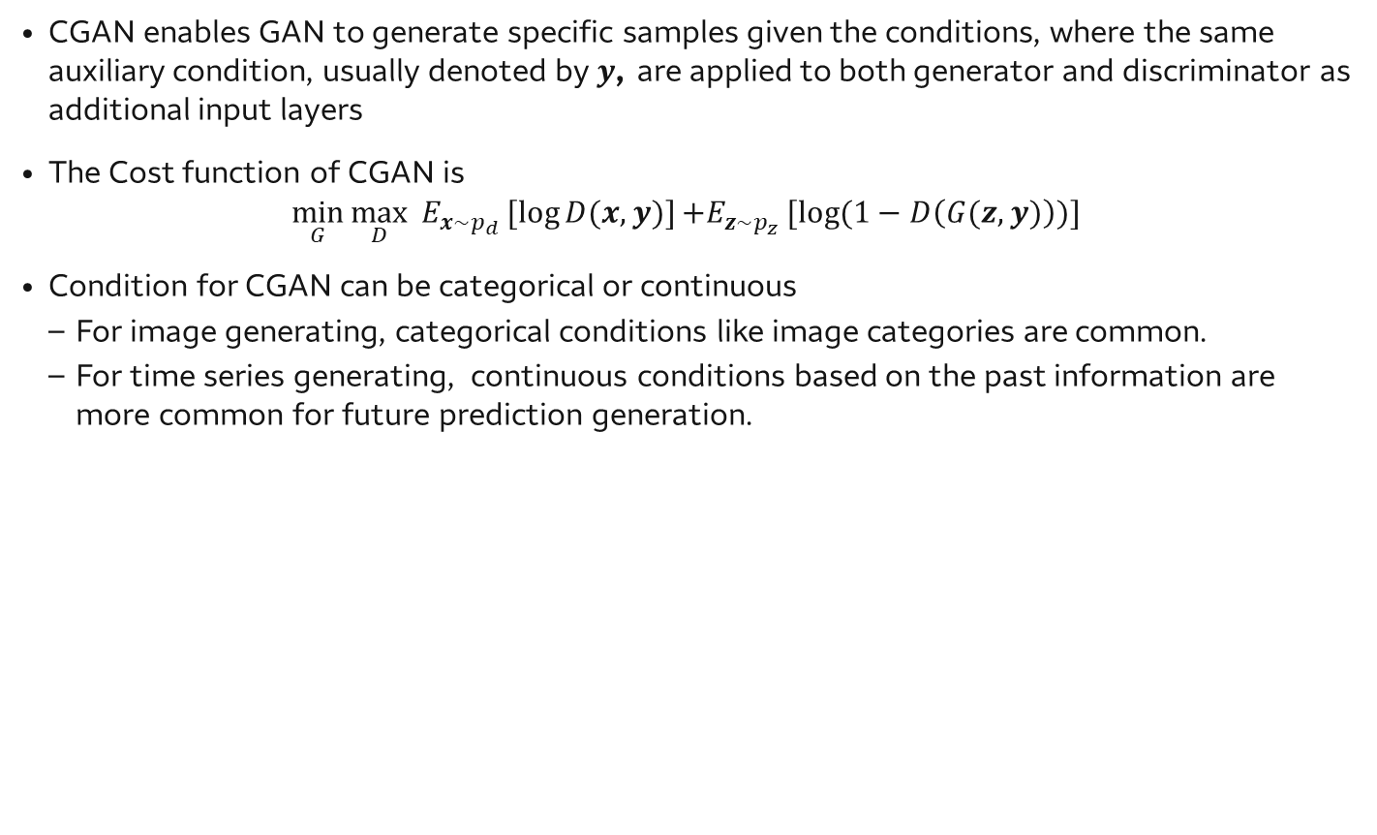
Conditional GAN (CGAN)
CGAN enables GAN to generate specific samples given the conditions, where the same auxiliary condition, usually denoted by$y$, are applied to both generator and discriminator as additional input layers
The Cost function of CGAN is
$$\min_{G}{\max_{D}{E_{x\sim p_{d}}[log{D(x,y)}]}}{+E_{z\sim p_{z}}[log{(1−D\left(G(z,y)\right))}] }$$
Condition for CGAN can be categorical or continuous
For image generating, categorical conditions like image categories are common.
For time series generating, continuous conditions based on the past information are more common for future prediction generation.
Generated MNIST digits, each row conditioned on one label (0,1,..., 9)

Slide 14
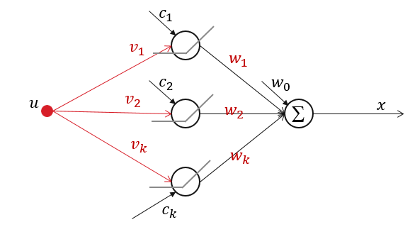
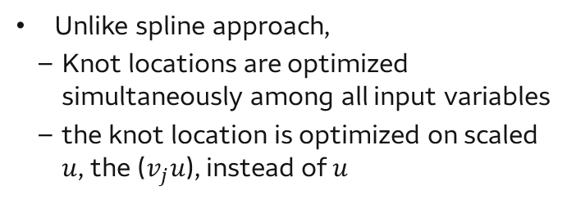
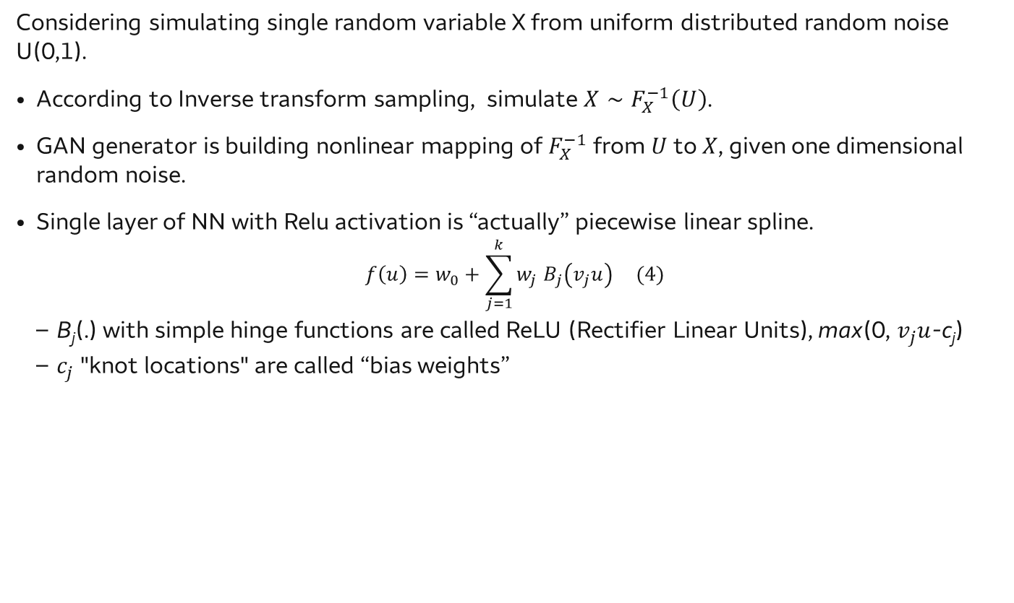
Rationale of GAN
Considering simulating single random variable X from uniform distributed random noise U(0,1).
According to Inverse transform sampling, simulate $X∼F_{X}^{−1}\left(U\right)$.
GAN generator is building nonlinear mapping of $F_{X}^{−1}$ from $U$ to $X$, given one dimensional random noise.
Single layer of NN with Relu activation is “actually” piecewise linear spline.
$$f\left(u\right)=w_{0}+\sum_{j=1}^{k}{{w_{j} B}_{j}\left(v_{j}u\right)} (4)$$
B_{j}(.) with simple hinge functions are called ReLU (Rectifier Linear Units), max(0, $v_{j}u$-c_{j})
$c_{j}$"knot locations" are called “bias weights”
Unlike spline approach,
Knot locations are optimized simultaneously among all input variables
the knot location is optimized on scaled $u$, the ($v_{j}u$), instead of $u$

Slide 15
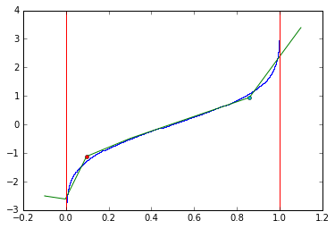
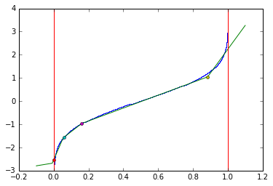
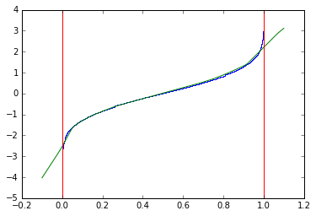
Rationale of GAN (Cont)
Let us simulate a N(0,1) distribution from uniform U(0,1) random noise with GAN
In the following plots, the blue line is inverse CDF from U(0,1) (x-axis) to N(0, 1) (y-axis), and the green line is the spline approximation trained by GAN.
Left :1-layer with 7 nodes with single dimensional noise
Middle: 1-layer with 100 nodes with single dimensional noise
Right: 2-layer with 100*100 nodes with single dimensional noise
Note that: some nodes are collapses together.

Slide 16
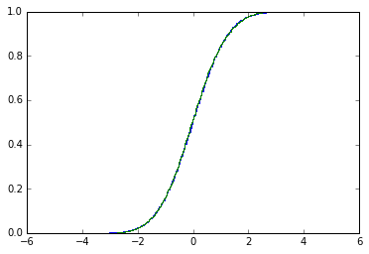
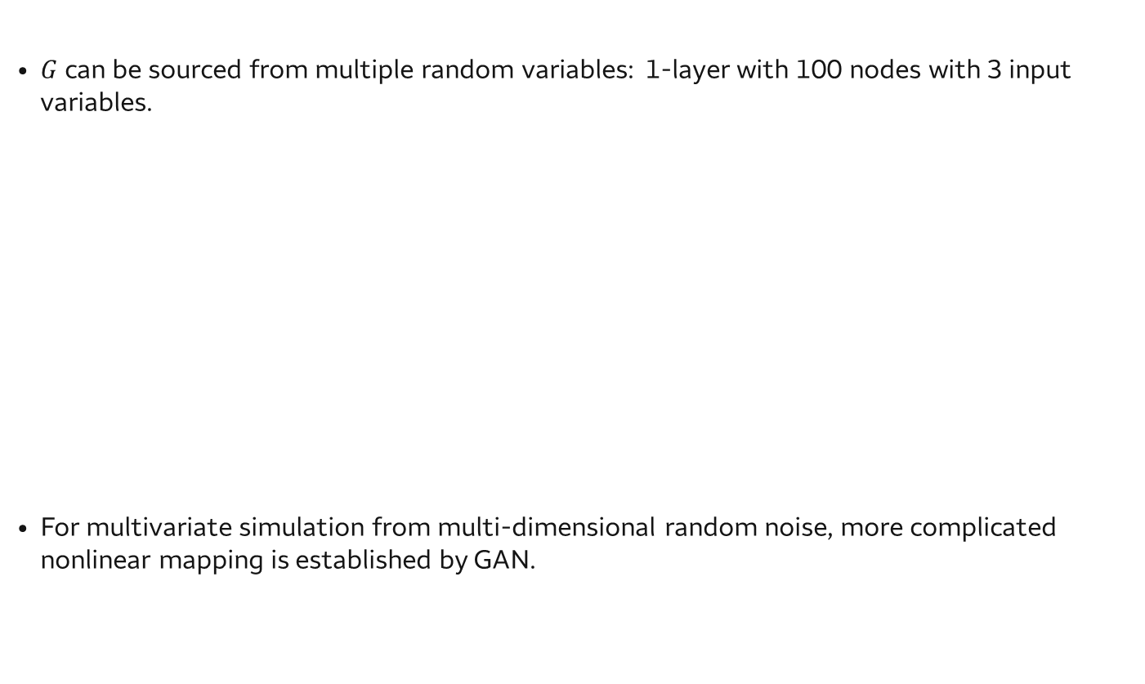
Rationale of GAN (Cont)
$G$can be sourced from multiple random variables: 1-layer with 100 nodes with 3 input variables.
For multivariate simulation from multi-dimensional random noise, more complicated nonlinear mapping is established by GAN.

Slide 17
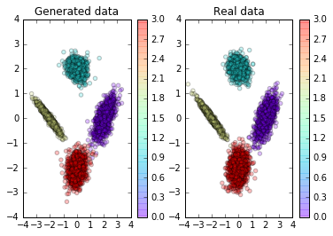
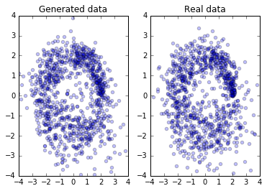
Simulation study I: Gaussian Mixture Model with categorical or continuous conditions
Gaussian Mixture Model with nominal categorical conditions
Four clusters of 2-dimensional Gaussian distributions with various means and variance
Gaussian Mixture Model with Continuous Conditions
Mean: along the circle with center at (0, 0) and radius = 2.
Variance: linearly increase along the circle in an anticlockwise direction.
Final data: Gaussian distributions with condition on means and the corresponding variances

Slide 18
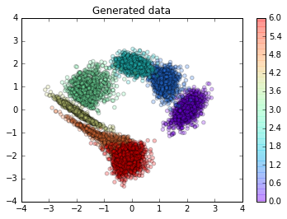
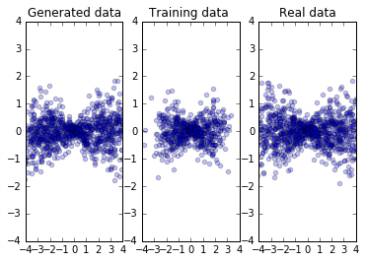
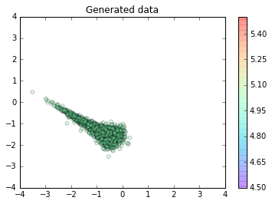
Simulation study I: Gaussian Mixture Model with categorical or continuous conditions
Interpolation
Extrapolation

Slide 19
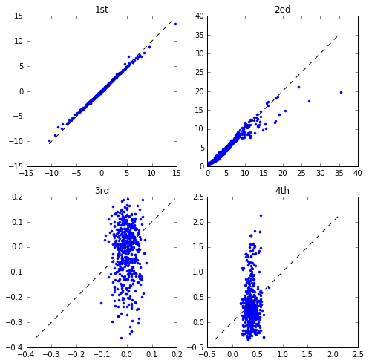
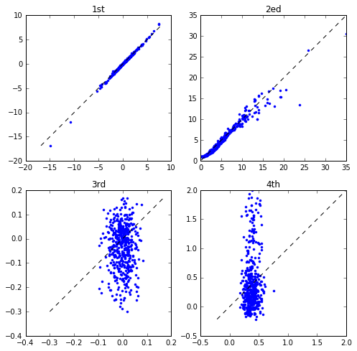
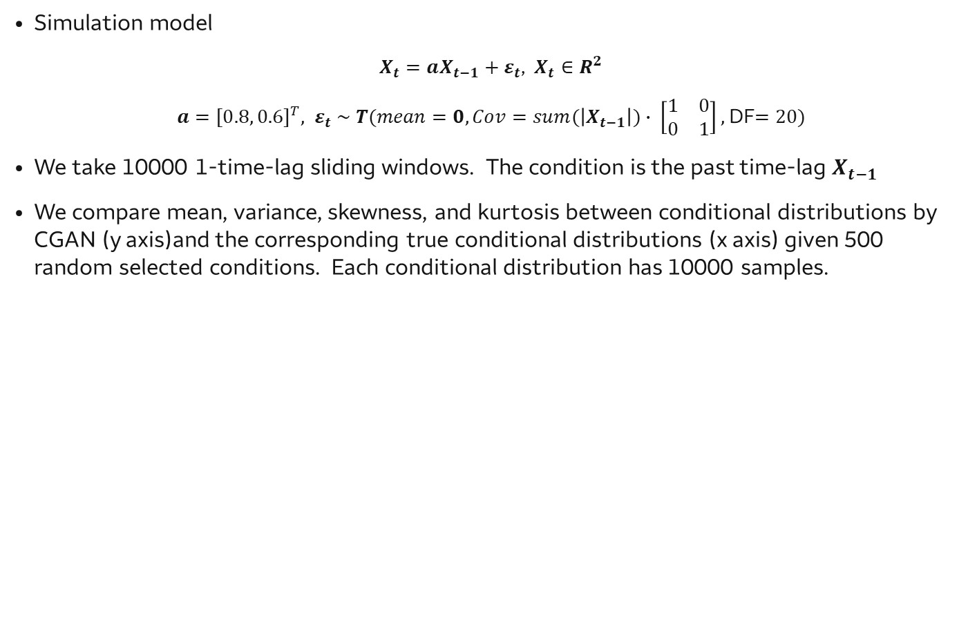
Simulation study II CGAN with Conti. Conditions VAR time series with time varying volatilities
Simulation model
$X_{t}=aX_{t−1}+ε_{t}$, $X_{t}∈R^{2}$
$a=[0.8, 0.6]^{T}, ε_{t} \sim T(mean=0, Cov=sum(\left|X_{t−1}\right|)∙ \left[\begin{matrix}1 & 0 \\ 0 & 1\end{matrix}\right],$DF$=20)$
We take 10000 1-time-lag sliding windows. The condition is the past time-lag $X_{t−1}$
We compare mean, variance, skewness, and kurtosis between conditional distributions by CGAN (y axis)and the corresponding true conditional distributions (x axis) given 500 random selected conditions. Each conditional distribution has 10000 samples.
1st time series
2nd time series

Slide 20
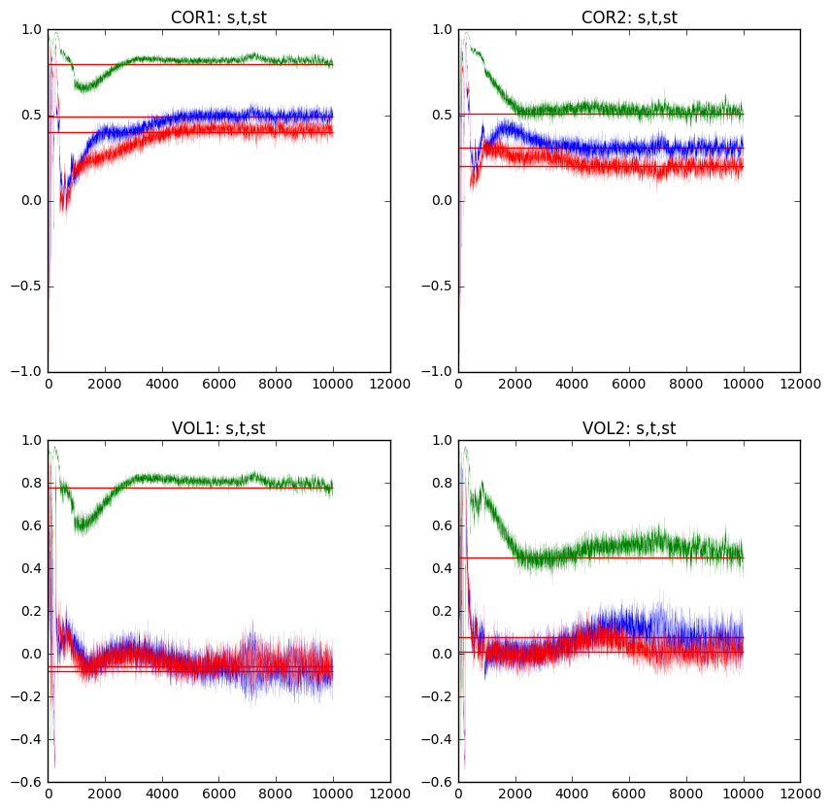
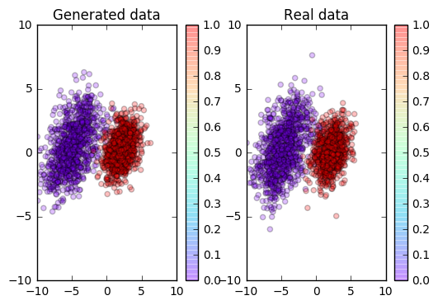
Simulation study II CGAN with Categorical Condition VAR time series with time varying volatilities
Checking the correlation structure and volatility dynamics
Checking the Distribution

Slide 21
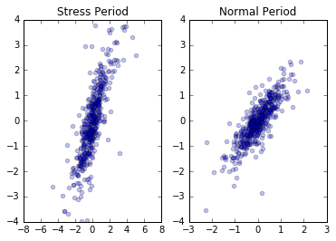
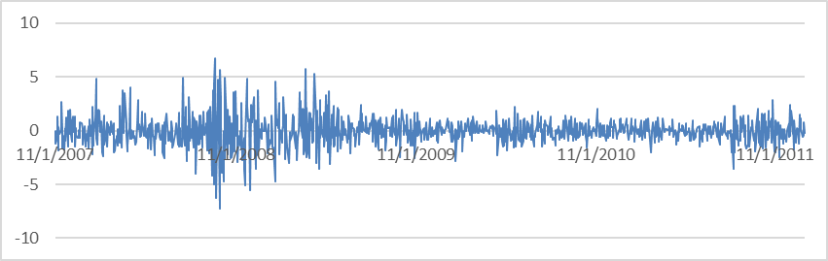
VaR and ES for equity 1-day returns
Equity spot prices for WFC and JPM from 11/1/2007 to 11/1/2011 are downloaded from yahoo finance. 1-day absolute returns are calculated and used as training data.
Stressed (11/2007-11/2009) and the normal periods (11/2009-11/2011) are separated by using an indicator of periods as a categorical condition.
The Historic Simulation method is one of the most popular methods used by major financial institutions. This method is usually based on a relatively small number of actual historical observations and may lead to jumpy and non-smooth tail distribution and poor VaR and ES output.
JPM: 1-day Return Time series

Slide 22
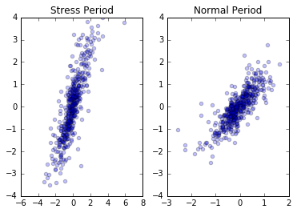
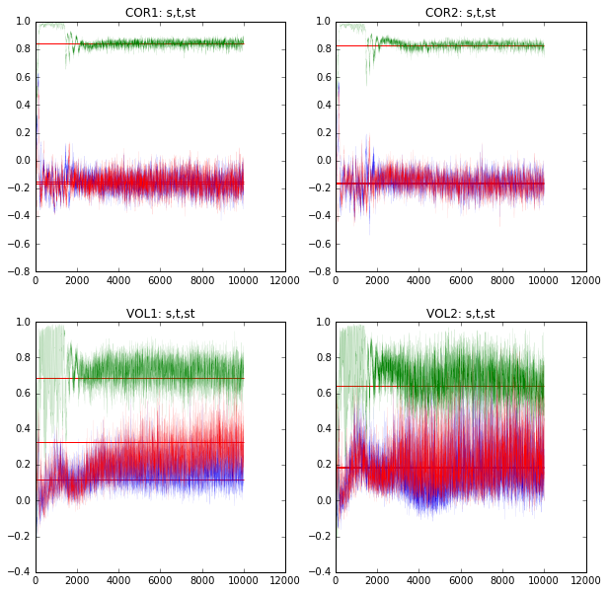
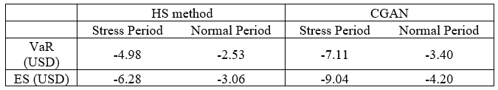
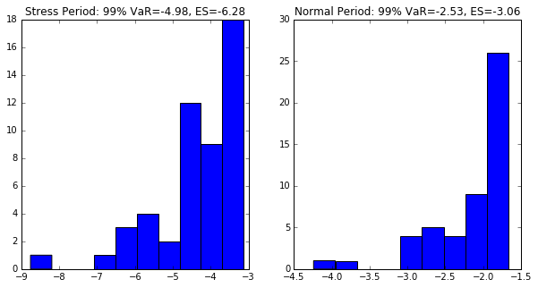
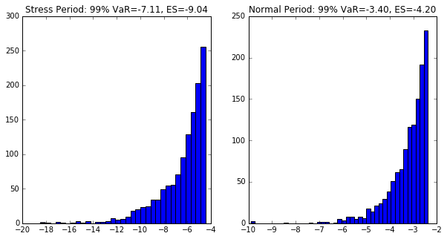
VaR and ES for equity 1-day returns
We train an CGAN model.
We use CGAN to learn the historical data for both the stressed and normal periods, and generate simulated sample set with the sample size 50 times larger than the original one.
we calculate the VaR and ES (See Table 1 below). The plots show that the large data set generated by CGAN generates a clear and smooth tail of the distribution.

Slide 23

VaR and ES backtesting for equity 1-day returns
Additional historical data for WFC and JPM stock prices from 11/1/2011- 11/1/2015 (around 1000 business days) is downloaded to implement the backtesting.
Since there has been no major financial crisis in this period, we use the VaR and ES from the normal period (in Table 1) as our measurement in the backtesting.
The expected breaches over 1000 days for 1-day 99% VaR is 10 days. Table 2 shows that the HS method may lead to an underestimated measurement of the portfolio loss, and CGAN outperformed the HS method in the calculation of VaR and ES for this example.

Slide 24


Economic Forecasting Model
CCAR requires multiple economic forecasts and different capital requirements during different hypothetical economic projections.
CGAN-based economic model provides an alternative approach to produce multi-quarter forecasts at once, and assess the distributions of the forecast paths.
Five popular macroeconomic index data from 1956 quarter 1 to 2016 quarter 3 from the U.S. Census Bureau: real Gross Domestic Product (GDP), unemployment rate (Unemp), Federal fund rate (Fedrate), Consumer Price Index (CPI) and 10-year treasury rate
Time series data : 5 variable x 242 quarter
Output data for CGAN: 230 sample x 5 variable x 9 quarter
Conditional data for CGAN: 230 sample x 5 variable x 4 quarter
(Left Plot) Fedrate is shocked upward by one standard deviation in the last quarter. The average forecast is generated and compared before and after the shock. A positive shock to the Fedrate suppresses the economic activity and leads to a higher Unemp compared to baseline in black.
(Right Plot)100 forecasting paths of GDP generated by CGAN using the most recent four-quarter historical values as conditions.

Slide 25

Discussion
Application in high dimensional data: Neyshabur et al. proposed training a single generator simultaneously against an array of discriminators, each of which looks at a diﬀerent random low-dimensional projection of the data.
GAN and CGAN for pricing models.
GAN with LSTM for Garch:

